Slide 1


Slide 2

MID-TERM PRESENTATION on PERCOLATION
Submitted by
OJASVI SINGH CHAUHAN (Enroll No. R134218111)
SHRISHTY DAYAL (Enroll. No. R134218158)
Under the guidance of
Ms. Deepa Joshi
Assistant Professor ,Department of Systemics

Slide 3
ABSTRACT
The theory of percolation was first introduced some time ago to describe penetration of fluids in porous media, and the subject has since been intensively studied, primarily in the field of physics. However, little direct use of percolation theory results has been made to date in the field of hydrology. The theory has been extensively developed as a branch of statistical physics and has found successful applications in a diverse range of problems including the design of electronic and magnetic materials, conceptualization of geometrical and topological characteristics of porous media, and understanding of miscible and immiscible displacements in discarded media.
KEYWORDS: porous media; percolation; hydrology; statistical physics;

Slide 4
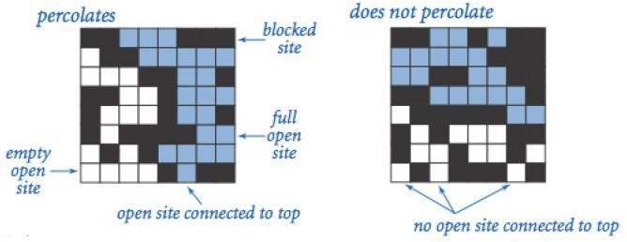
INTRODUCTION
Percolation is the process of a liquid moving slowly through a substance that has very small holes in it, or in other words, the process of something spreading slowly [1].
Fig 1 Percolation in 8-by-8 grid system [2]

Slide 5
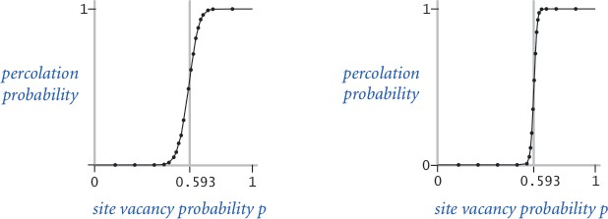
When N is sufficiently large, there is a threshold value p* such that when p < p* a random N- by-N grid almost never percolates, and when p > p*, a random N-by-N grid almost always percolates.
Fig 2 Probability distribution graph [3]

Slide 6
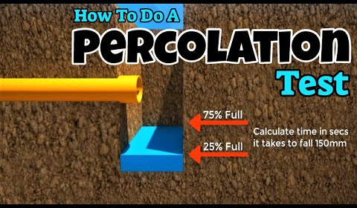
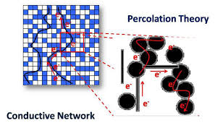
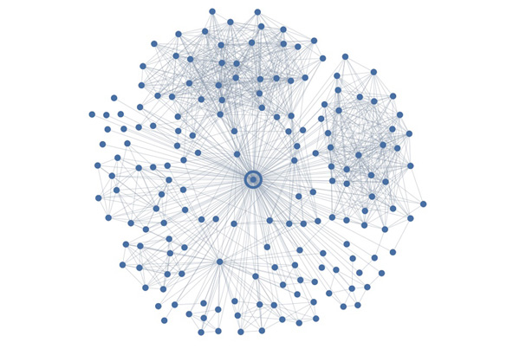
REAL LIFE EXAMPLES
In the field of hydrology, Percolation can be used in making drainage systems, sewer systems, in irrigation of farms, etc
In the field of Electricity, percolation can be used to make conductors and semi conductors.
Metal cost can be reduced by ensuring the right amount of usage of metals in a substance.
3. In Social networking sites like Facebook, Linkedin, etc. we can apply this algorithm to check whether person A is connected to person B or not.,

Slide 7
PROBLEM STATEMENT
What fraction of the material need to be metallic so that the composite system is an electrical conductor.
What fraction of the ground should be used to lay the pipes to ensure the water supply with the minimum effort.
In the social network where it's people connected and either there's a connection between two people or not.

Slide 8
LITERATURE REVIEW
Title |  | Author | Remarks
Percolation Theory and Its Application to Groundwater Hydrology |  | Brian Berkovitz | The methods of percolation theory are discussed, previous applications of the theory to hydrological problems are reviewed, and future directions of study are suggested.
The Union-Find problem is Linear |  |  | This paper work has presented a new proof which shows that the complexity of the union-find problem is linear.
Data Structures and Algorithms for Disjoint Set Union Problems |  | Galil, Zvi & Italiano, Giuseppe | Explained the Data Structure for disjoint set union find problem. They showed that union-find visualization is done on a tree but its actual implementation is done on an array.
Theory of Percolation |  | Swami Iyer | In his theory he basically talked about how to calculate probability threshold using Monte Carlo simulation and various mathematical calculations
Link
[6]
[7]
Hantao Zhang
[8]
[9]

Slide 9
OBJECTIVES
To create an application that recognizes whether the system will percolate or not.
Sub Objectives:
To detect the connected components of water inflow.
To calculate the threshold and probability of percolation.
To create an interactive visualizer for communicating with grid.

Slide 10
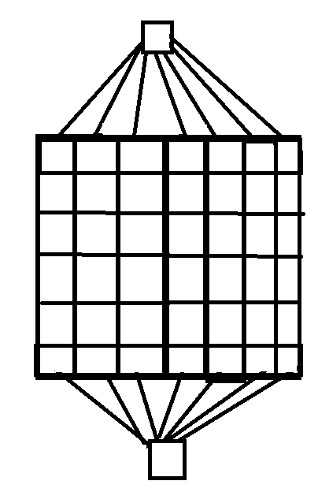
METHODOLOGY
For this project, we will use the applications of Union & Find data structures to achieve the goal.
The entire implementation of this project can be summarized in the following steps:
Create an API for the union-find algorithm: Make findset() and unionset() functions.
Optimize the Algorithm: O(n) -> O(logn) -> O(1).
Analyze the Grid: Take input as per requirement of input.
Virtual Top Site: Connect every cell of top & bottom row with source and sink.
Avoid backwash problem: Avoid backflow of water from sink to cells.
Check the connection: Final step to check connection.
Source
Sink

Slide 11
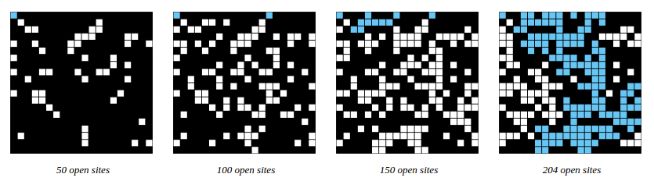
Monte Carlo simulation: Monte Carlo methods, or Monte Carlo experiments, are a broad class of computational algorithms that rely on repeated random sampling to obtain numerical results. The underlying concept is to use randomness to solve problems that might be deterministic in principle [10].
For example, if sites are opened in a 20-by-20 grid according to the snapshots below, then our estimate of the percolation threshold is 204/400 = 0.51 because the system percolates when the 204th site is opened.
Fig 3 Site distribution at various time [11]

Slide 12
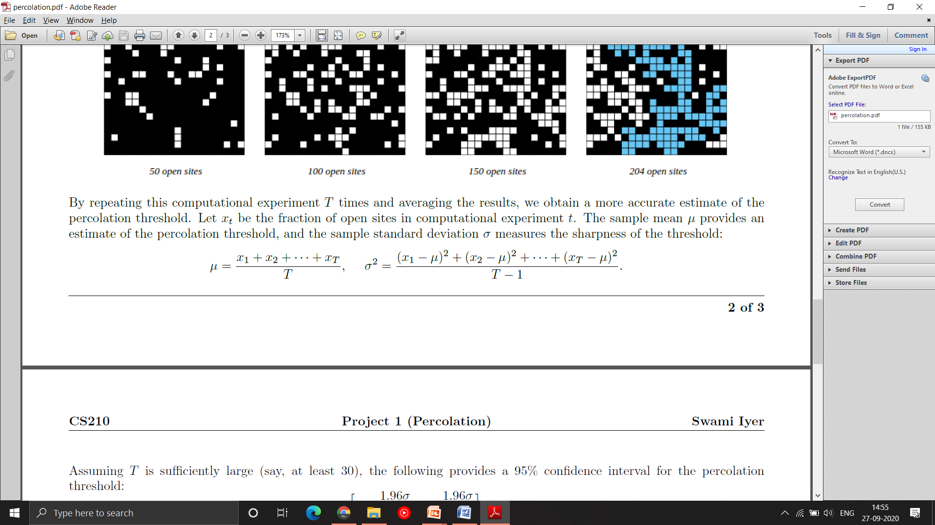
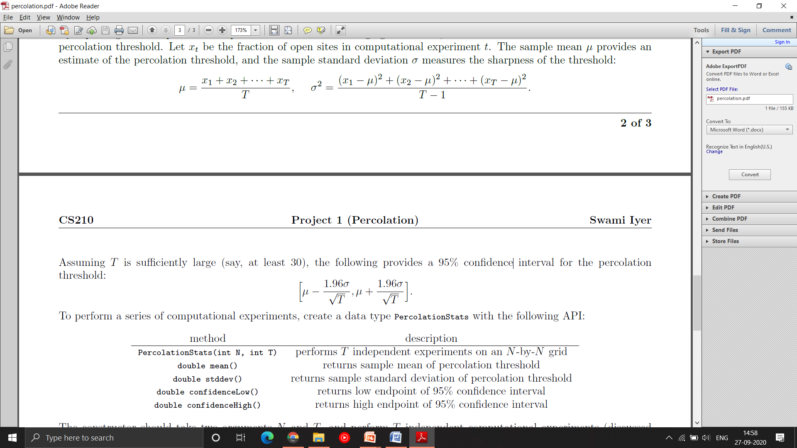
By repeating this computational experiment T times and averaging the results, we obtain a more accurate estimate of the percolation threshold. Let x_{t} be the fraction of open sites in computational experiment t. The sample mean μ provides an estimate of the percolation threshold, and the sample standard deviation σ measures the sharpness of the threshold:
Assuming T is sufficiently large (say, at least 30), the following provides a 95% confidence interval for the percolation threshold:

Slide 13
SYSTEM REQUIREMENTS
Hardware:
RAM: 4GB
Disk Space: 500 MB
Software:
Sublime Text( or any other C++ IDE)
G++ Compiler should be installed.
Operating System:
Windows or Linux.

Slide 14
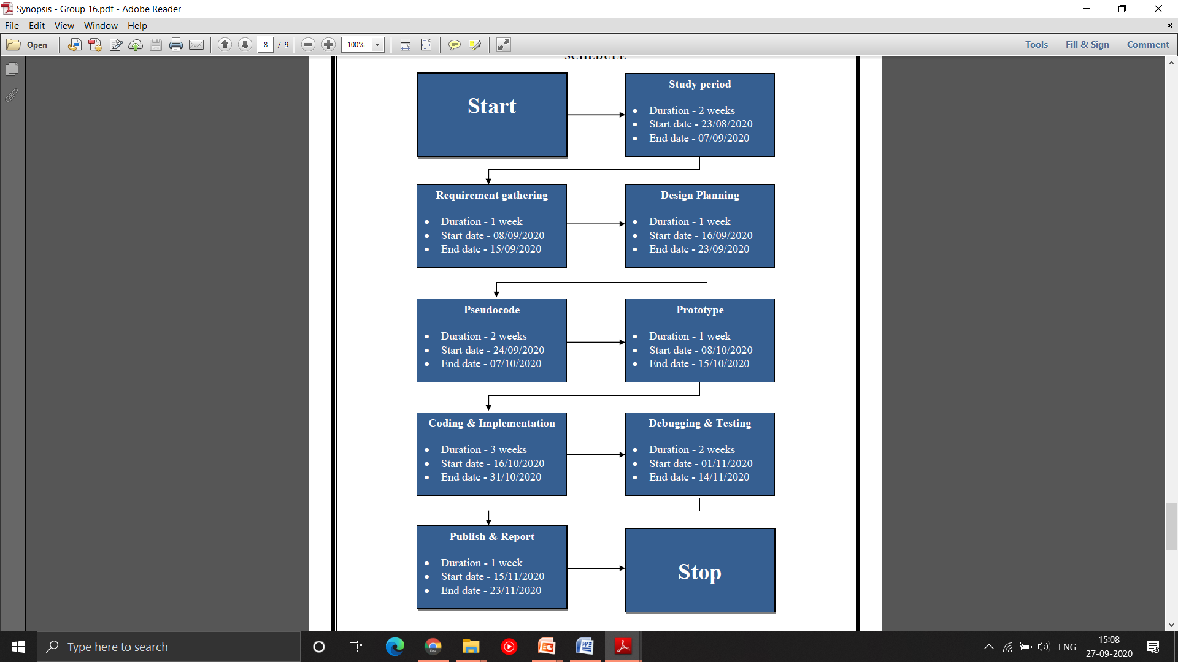
SCHEDULE (Pert Chart)

Slide 15
PROJECT PROGRESS
Task Achieved:
Requirement Gathering.
Design Planning
Pseudo Code
We are proceeding step by step as per Pert Chart and currently we are working on Pseudo code.

Slide 16
REFERENCES
[1] dictionary.cambridge.org, ‘Percolation search’, [online] Available:
<https://dictionary.cambridge.org/dictionary/english/percolation.html> [Accessed: 22 August 2020].
[2] Iyer, S., 2016. Percolation. [online] swamiiyer.net. Available at: <https://www.swamiiyer.net/cs210/projects.html> [Accessed 18 August 2020].
[3] Sedgewick, R., 2011. Algorithms. [online] princeton.edu. Available at:
<https://www.cs.bu.edu/~snyder/cs112/CourseMaterials/AlgorithmsChapterOne.pdf> [Accessed 17 August 2020].
[4] Iyer, S., 2016. Percolation. [online] swamiiyer.net. Available at: <https://www.swamiiyer.net/cs210/projects.html> [Accessed 18 August 2020].
[5] Sedgewick, R., 2011. Algorithms. [online] princeton.edu. Available at:
<https://www.cs.bu.edu/~snyder/cs112/CourseMaterials/AlgorithmsChapterOne.pdf> [Accessed 17 August 2020].
[6] Berkowitz, B., & Balberg, I. (1993). Percolation theory and its application to groundwater hydrology.
Water Resources Research, 29(4), 775-794.
[7] Zhang, H., 2008. The Union-Find Problem Is Linear. [online] semanticscholar.org. Available at:
<https://www.semanticscholar.org/paper/The-Union-Find-Problem-Is-Linear-Zhang/> [Accessed 21
August 2020].
[8] Galil, Z., & Italiano, G. F. (1991). Data structures and algorithms for disjoint set union problems. ACM Computing Surveys (CSUR), 23(3), 319-344. (DSA for disjoint set union find problem)
[9] ] Iyer, S., 2016. Percolation. [online] swamiiyer.net. Available at: <https://www.swamiiyer.net/cs210/projects.html> [Accessed 18 August 2020].
[10] Monte Carlo method. (2002, June 11). https://en.wikipedia.org/wiki/Monte_Carlo_method
[11] Iyer, S., 2016. Percolation. [online] swamiiyer.net. Available at: <https://www.swamiiyer.net/cs210/projects.html> [Accessed 18 August 2020].

